Slide 1
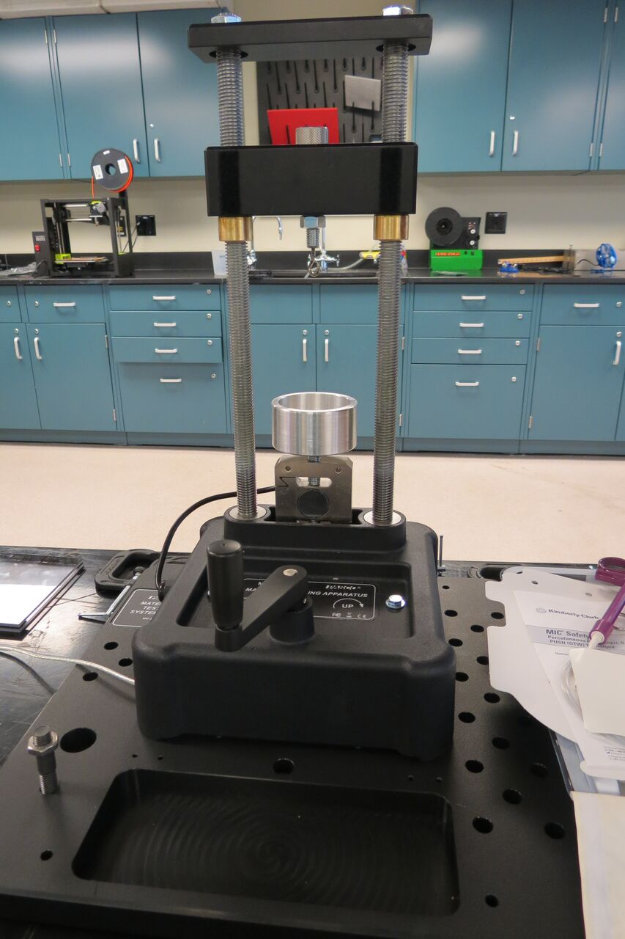
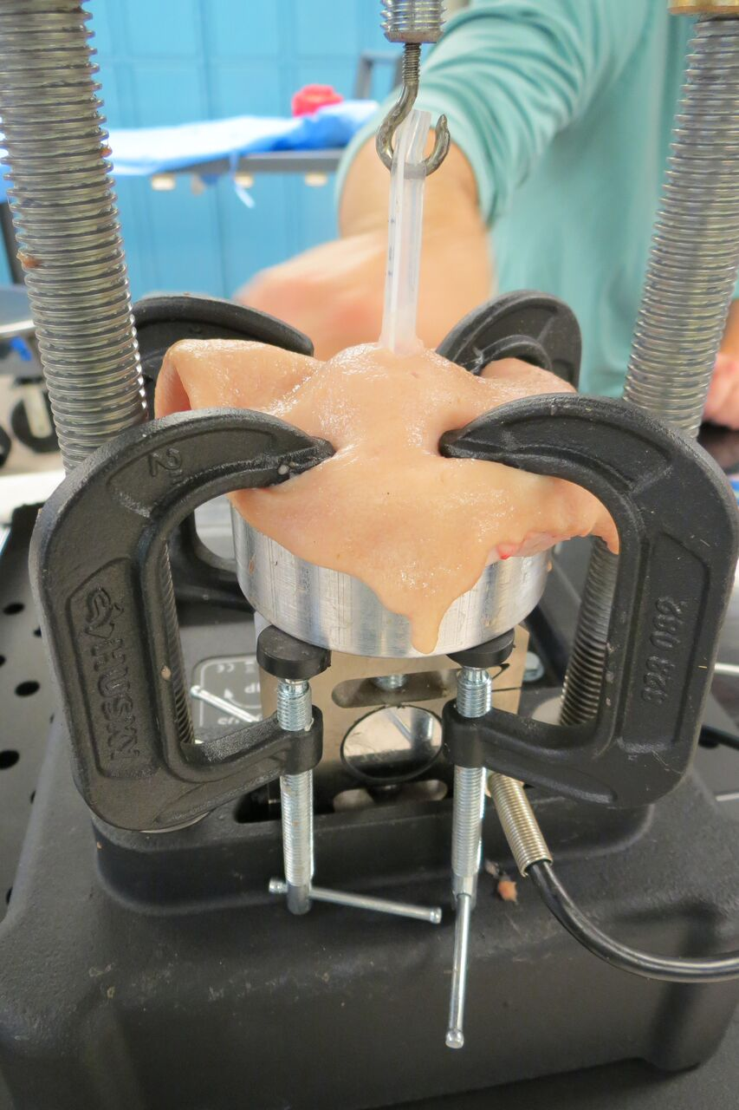
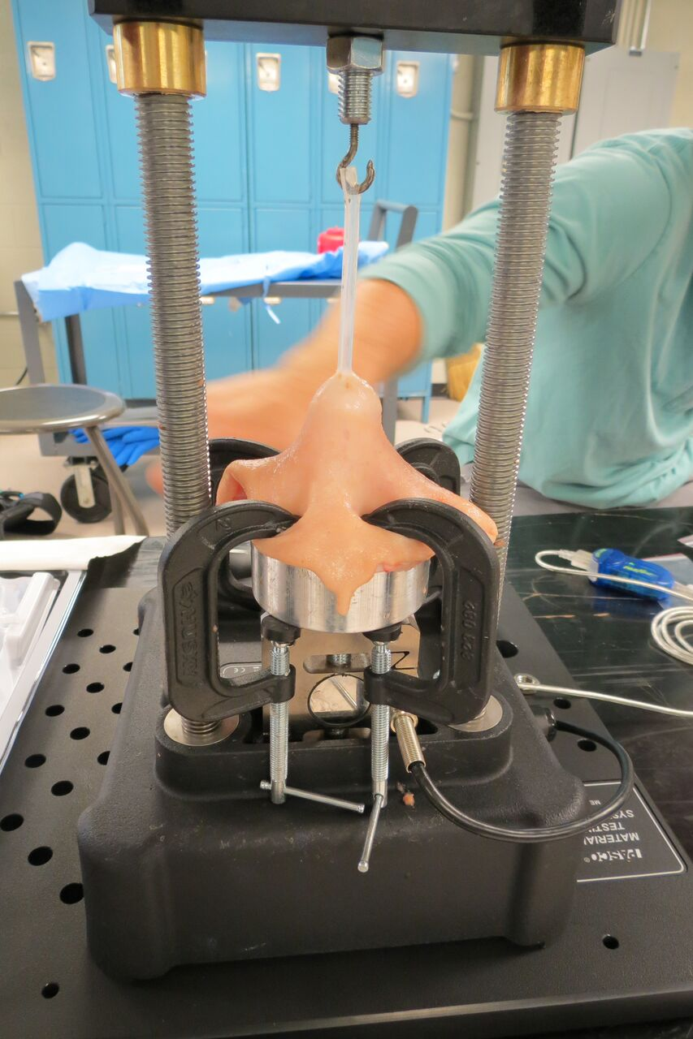
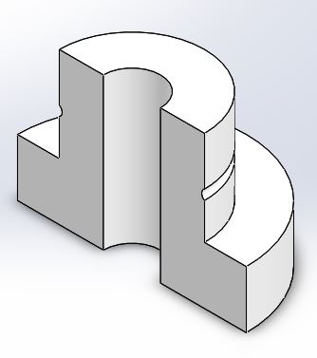
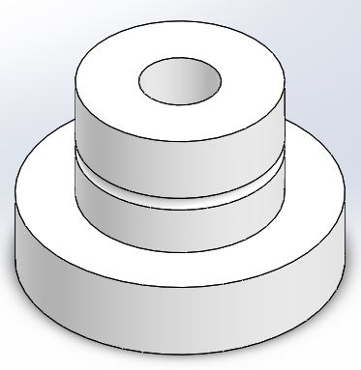
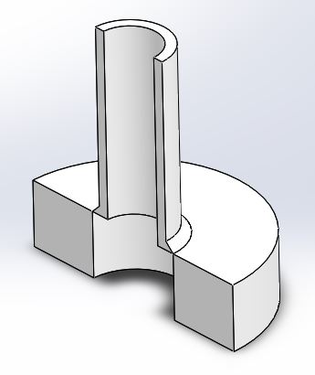
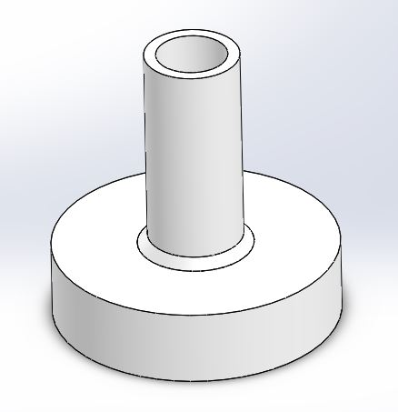
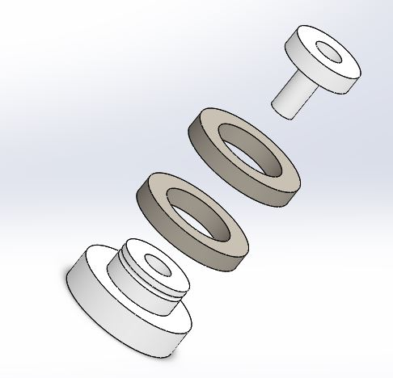
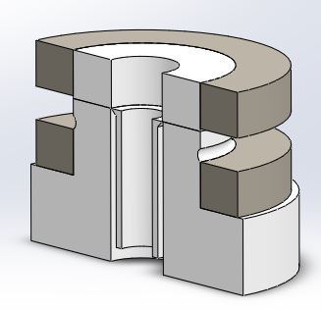
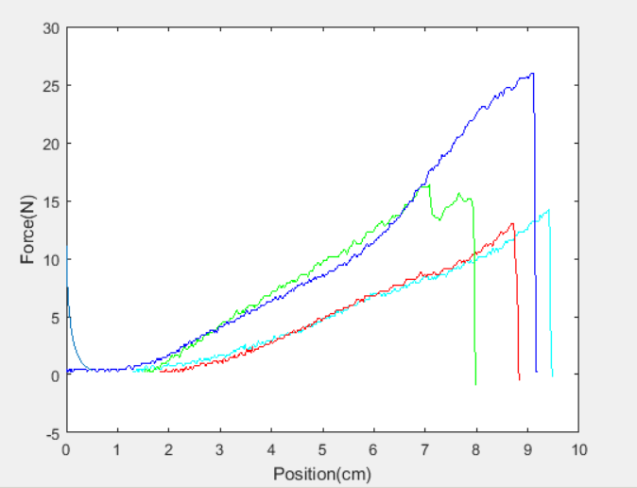
Detachable Percutaneous Endoscopic Gastrostomy Tube (PEG) Tube
Michael Aleman, Zachary Bales, Trevor Hepburn, Breanna J. Rhyne
VolTech Designs
University of Tennessee, Knoxville
Background
Pull-Force Testing
Final Design Overview
Percutaneous endoscopic gastrostomy (PEG) tubes are medical devices that allow for the delivery of enteral nutrition and drugs when a patient cannot or will not swallow due to disease or traumatic injury.
A problem exists with patients who dislodge their tubes from the stomach because they are confused, aggressive, or clumsy.
This happens in as many as 12.8% of tube placements, and it incurs unnecessary costs and/or dangers to the patient. This inconveniences surgeons who have to replace the tubes.
Our solution was to create a fracture plane in the tube body which would break outside the body at a force lower than what would be required to remove it.
The force was detected by the device against displacement brought on by the device.
To find the amount of force to remove a tube, the team used custom parts for a PASCO ME-8236 Materials testing device and a pig stomach.
A tube was placed in cross sections of stomach, and the tube was pulled until it was removed.
Our designs employs a magnetic coupling system that ideally breaks at a force lower than that to remove the PEG tube from the stomach entirely.
VolTech Designs created base values for the detachable PEG tube and modeled both the female and male components in SolidWorks.
Washer-like magnets, that possessed similar forces found through pull-force testing, were purchased and incorporated into the design.
(a)
(b)
(c)
(d)
The force was detected by the device against displacement brought on by the device.
The drops on the graph represent the moment where the tube was dislodged from the stomach sample.
The average force of removal for our four trials was 17.3 N (about 3.9lbs).
Based on this data, our fracture plane needs to be designed to break at a force significantly lower than this average; we chose 2 lbs. (about half; giving a factor of safety of 2).
Design Specifications
The design needed to retain the general purpose of current PEG tube designs.
It must preserve the ability to remove any metal components in the case of a medical procedure.
The device should not create additional obstructions to the flow of fluids within the tube.
SolidWorks renderings of (a) section view of female part, (b) isometric view of female part, (c) section view of male part, (d) isometric view of female part
(a)
(b)
Design Methodology
The design concept was derived from the defense mechanism of the gecko in which the gecko instinctively drops its tail in order to prevent being grabbed by it.
Magnetic coupling was chosen because it provided the most consistent option for replicating the separation force.
O-rings were crucial in the magnetic coupling because they provided the separation that was necessary to create the desired attraction force.
SolidWorks renderings of (a) an exploded view of the detachable PEG tube assembly, (b) an assembled view of the detachable PEG tube
Conclusions and Future Direction
Revisions to the original drawing have been and will continue to be made until an appropriate fit and tolerances have been found.
The detachable assembly needs to be tested to see how the fluid flow of the formula used in PEG tubes compares to fluid flow in our design.
This work was supported in part by The University of Tennessee Knoxville through the Mechanical, Aerospace, and Biomedical Engineering Department and by Dr. Jeffrey Reinbolt and Amy Curran

